Slide 1
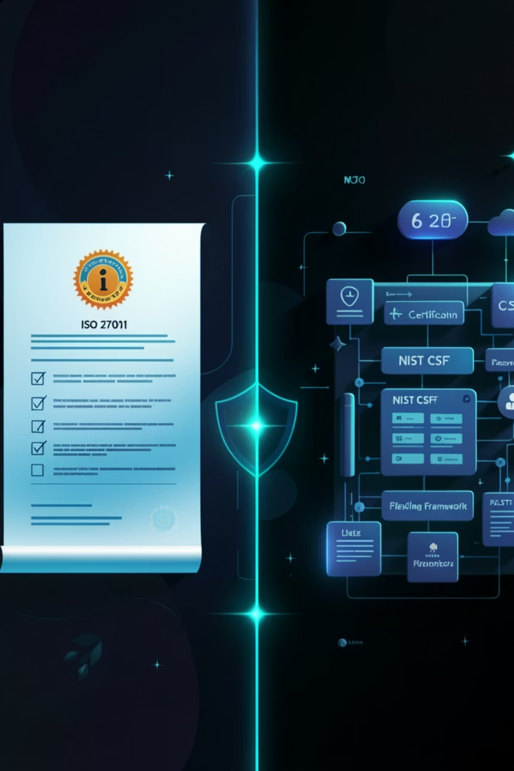
ISO 27001 vs NIST CSF

Slide 2

ISO 27001 and NIST CSF are two of the most sought-after compliance frameworks in the cybersecurity landscape today. While ISO/IEC 27001 takes a comprehensive approach to information security management, NIST sets the standards for information security, develops new technologies, and provides metrics to drive innovation and industrial competitiveness.

Slide 3






What is NIST CSF?
Overview
Example
NIST CSF is a voluntary framework developed by the National Institute of Standards and Technology that provides guidelines and best practices to help organizations manage their security posture and minimize cybersecurity risks. The framework is flexible rather than prescriptive and takes a risk-based approach to support organizations of any size, sector, or security maturity.
An e-commerce company uses NIST CSF to build its cybersecurity program from scratch. It starts by identifying all customer data assets (Identify), deploys firewalls and MFA (Protect), sets up a SIEM tool like Splunk (Detect), creates an incident response plan (Respond), and establishes a disaster recovery plan (Recover).
The NIST CSF is built around six core functions:
Govern
Identify
Newly added in CSF 2.0
Understand assets, people, data, and systems to manage cybersecurity risks
Protect
Detect
Implement safeguards to ensure delivery of critical services
Identify the occurrence of cybersecurity events
Respond
Recover
Take action regarding a detected cybersecurity incident
Maintain resilience and restore capabilities after an incident

Slide 4

NIST Implementation Tiers
Tier Level
Description
Details
Tier 1
Partial
No formal cybersecurity processes in place
Tier 2
Risk Informed
Aware of risks but no formal processes
Tier 3
Repeatable
Policies exist but not fully systematic
Tier 4
Adaptive
Real-time tools and processes fully operational
Real-World Example: A startup with no security policies is at Tier 1. After implementing NIST CSF guidelines — deploying EDR, SIEM, and incident response playbooks — it progresses to Tier 4, where it can isolate attacks, reduce threat surfaces, and recover quickly.

Slide 5

What is ISO 27001?
ISO 27001 is a globally recognized standard that defines requirements for implementing and maintaining an Information Security Management System (ISMS). It was originally released in 2005, substantially updated in 2013, and most recently updated in 2022.
ISO 27001 is structured around:
Example
A financial services company seeking to expand into European markets pursues ISO 27001 certification to demonstrate compliance with data protection standards to clients and regulators. It undergoes a formal third-party audit, implements all required controls, and receives certification valid for three years.
Clauses 4 to 10 — Organizational requirements
93 Annex A Controls — Covering areas such as access control, cryptography, physical security, and incident management

Slide 6
Key Differences
Basis
NIST CSF
ISO 27001
Purpose
Improve cybersecurity risk posture
Establish a formal ISMS
Certifiable
No
Yes, through accredited third-party auditors
Structure
6 Functions: Govern, Identify, Protect, Detect, Respond, Recover
Clauses 4–10 and 93 Annex A controls
Approach
Flexible and outcome-focused
Formal and prescriptive
Documentation
High-level guidance, no strict mandates
Requires detailed documentation
Best Suited For
Organizations enhancing cybersecurity maturity
Organizations requiring formal certification
Cost
Free, publicly available
Requires purchase of documentation and audit fees
Geographic Focus
Primarily US-based organizations
Globally recognized

Slide 7
Key Similarities
Despite their differences, NIST CSF and ISO 27001 share approximately 80% overlap in controls. Both frameworks:
Risk Management Approach
Control Selection
Continuous Improvement
Emphasize a risk management approach to cybersecurity
Encourage control selection based on organizational context
Focus on continuous improvement based on emerging threats
Common Security Domains
Widely Accepted Best Practices
Share common security domains including access controls, incident response, risk assessment, asset management, and business continuity
Offer widely accepted best practices such as encryption and employee awareness training

Slide 8
NIST 800-53 vs ISO 27001
Overview
Example
NIST 800-53 is a more specific framework designed primarily for US federal agencies and organizations that work with those agencies. ISO 27001 is for any organization looking to enhance its compliance posture and security readiness globally. NIST 800-53 focuses on the control of the flow of information from source to destination, whereas ISO 27001 is more focused on enabling organizations to protect themselves from security threats and safeguard their data assets.
A US government contractor handling classified defense data must comply with NIST 800-53 to meet federal requirements. A multinational SaaS company, however, pursues ISO 27001 to satisfy global enterprise clients and demonstrate internationally recognized security standards.

Slide 9
Real-World Scenario
A healthcare organization suffers a ransomware attack and must strengthen its security posture.
Using NIST CSF
Using ISO 27001
01
01
Identify
Risk Assessment
Conducts asset inventory, identifies patient data repositories
Conducts a formal risk assessment per ISO 27001 Clause 6
02
02
Protect
Annex A Controls
Deploys MFA, encrypts patient records, trains staff
Implements 93 Annex A controls including access control and cryptography
03
03
Detect
Documentation
Implements SIEM to monitor for anomalies
Documents all policies and procedures
04
04
Respond
Third-Party Audit
Activates incident response playbook, isolates infected systems
Undergoes a third-party audit and achieves ISO 27001 certification
05
05
Recover
Global Compliance
Restores data from backups, resumes operations within 48 hours
Demonstrates compliance to regulators and healthcare partners globally

